Slide 1
Building Components using Swing and JavaFX

Slide 2
Outline
Introduction to AWT and Swing: Concept, Applets, Swing Class Hierarchy, Components/Containers
Layout Management
GUI Controls
Menu Elements and Tooltips
Dialogs and Frames
Event handling and Listener Interfaces
Handling Action Events
JavaFX vs Swing
JavaFX Layouts
JavaFX UI Controls

Slide 3
AWT
AWT is the original GUI framework in Java, introduced with the first version of Java (JDK 1.0) in the mid-1990s.
It provides a set of classes and components that allow developers to create GUI applications.
AWT is built upon the native windowing system of the underlying operating system. This means that the appearance and behavior of AWT components are determined by the host operating system's graphical environment.
AWT components are heavyweight components, meaning that they directly map to and utilize the native windowing system's resources.
AWT provides a basic set of GUI components, including buttons, text fields, checkboxes, and menus.

Slide 4
SWING
Swing is a more advanced GUI framework built on top of AWT, introduced with the release of Java 2 (JDK 1.2) in 1998.
It is often referred to as the "Swing toolkit" or "Swing library."
Swing components are written entirely in Java and do not rely on the native windowing system. This allows Swing to have a consistent look and feel across different operating systems.
Swing components are lightweight components, meaning that they are not bound to the native windowing system and do not utilize its resources directly. Instead, they are rendered using Java code and can be customized extensively.
Swing provides a rich set of GUI components, including advanced controls like tables, trees, tabbed panes, and more.

Slide 5
AWT/SWING
In summary, AWT is the foundation of Java's GUI capabilities and provides a basic set of GUI components that utilize the native windowing system.
Swing, on the other hand, is a more advanced and flexible GUI framework built on top of AWT, offering lightweight components with consistent appearance and behavior across different platforms.
Swing components are written in Java and offer greater customization options compared to AWT.

Slide 6
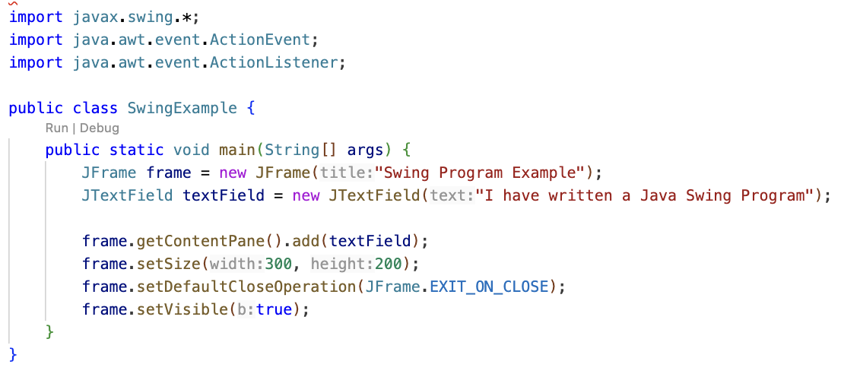
Creating Frame Object
Creating a text field object with a text
Adding text field to the frame

Slide 7
Swing Class hierarchy
Key classes include JFrame, JPanel, JButton, JTextField, etc.
Swing components are prefixed with the letter 'J' to distinguish
Components: Individual GUI elements, e.g., buttons, text fields.
Containers: Components that can contain other components, e.g., frames, panels.
Swing provides a wide range of components to create complex and interactive GUIs.

Slide 8
Layout Management
Layout managers control the arrangement and sizing of components within a container.
Different layout managers provide different strategies for organizing components
FlowLayout: Arranges components in a left-to-right flow.
BorderLayout: Divides the container into five regions (North, South, East, West, Center).
GridLayout: Arranges components in a grid of rows and columns.
BoxLayout: Arranges components in a single row or column.
CardLayout: Manages multiple components, showing only one at a time like a deck of cards.

Slide 9
Layout Management (contd...)
Layout managers are set using the setLayout method on a container.
JFrame frame = new JFrame("BorderLayout Example"); frame.setLayout(new BorderLayout());______________
The choice of layout manager depends on the desired GUI structure and behavior.
Layout managers in Java are used to handle the arrangement and sizing of components within a container
They play a crucial role in GUI (Graphical User Interface) programming by providing a flexible and dynamic way to organize graphical elements within a window

Slide 10
GUI Controls
GUI controls, also known as UI controls or components, refer to the interactive elements in a graphical user interface (GUI) that users can interact with.
These controls are the building blocks of a GUI application, allowing users to input data, make selections, and trigger actions.
GUI controls are essential for creating interactive and user-friendly applications
They facilitate user input and interaction, enabling users to perform various tasks efficiently

Slide 11
GUI Controls (contd...)
Buttons: Trigger actions when clicked.
Text Fields: Allow users to input text.
Checkboxes: Enable users to make binary choices.
Radio Buttons: Provide options for exclusive selection.
Combo Boxes: Present a list of options for selection.
Sliders: Adjust values within a specified range.
List Boxes: Display a list of items for selection.

Slide 12
Menu Elements
Menus are a common UI pattern that organizes commands and options
Menu elements include:
Menu Bar: A horizontal bar containing menus.
Menu: A list of commands or options.
Menu Item: An individual option within a menu.
Submenu: A nested menu within another menu.
Menus provide a structured way to organize functionality, making it easily accessible to users

Slide 13
Tooltip
Tooltips are small informational pop-ups that appear when users hover over a UI element
They provide brief descriptions or additional information about the associated element

Slide 14
Dialogs
Dialogs are separate windows that prompt users for input, display information, or request confirmation
Common types include:
Message Dialogs: Display messages to the user.
Input Dialogs: Prompt users for input.
File Choosers: Allow users to select files or directories.
Option Dialogs: Present a set of predefined options.
Dialogs are used for communication between the application and the user
They provide a way to gather input, convey messages, or obtain user confirmation.

Slide 15
Frames
Frames are the main windows of a GUI application
They serve as containers for other GUI elements, such as panels, controls, and dialogs.
Frames provide the overall structure of the application
They contain and organize the components necessary for the application's functionality.

Slide 16
Event in AWT/SWING
To handle events, we need to implement event listeners or adapters. Some commonly used listener interfaces in AWT include:
ActionListener: Handles action events.
MouseListener: Handles mouse-related events.
KeyListener: Handles keyboard-related events.
WindowListener: Handles window-related events.

Slide 17
AWT Event Hierarchy
The AWT (Abstract Window Toolkit) Event Hierarchy refers to the structure and organization of different types of events in AWT
Event Object:
At the top of the hierarchy is the java.util.EventObject class.
This class serves as the base class for all events in Java.
It provides common methods and properties that are shared by all event objects.
Component-Level Events:
Component-level events are generated by individual GUI components (e.g., buttons, text fields, etc.).
These events are subclasses of java.awt.AWTEvent.

Slide 18
AWT Event Hierarchy (contd...)
Container-Level Events:
Container-level events are generated by container components (e.g., panels, frames, etc.) and are subclasses of java.awt.event.ContainerEvent.
These events capture changes in the container's structure, such as components being added, removed, or rearranged within a container.
Window-Level Events:
Window-level events are generated by top-level windows, such as frames or dialog boxes, and are subclasses of java.awt.event.WindowEvent.
These events capture events related to window openings, closings, iconifications, or deiconifications.
System-Level Events:
System-level events represent events that occur at the system level and are subclasses of java.awt.event.SystemEvent.
Examples include events related to the user session, such as the user logging in or logging out.

Slide 19
Semantics and low level Events in AWT, Event Handling
Semantics in event handling refers to the meaning or purpose associated with a particular event. For example, a button click event may trigger a specific action like submitting a form.
AWT provides low-level events that represent low-level input, such as mouse or keyboard actions. These events are handled by components like buttons or text fields.
The AWT event handling mechanism involves registering event listeners or handlers on components to capture and process specific events.
Event handlers implement specific listener interfaces, such as ActionListener or MouseListener, and define methods to handle events triggered by user actions.

Slide 20
Individual Events. Separating GUI and Application code
Individual events refer to specific actions or occurrences triggered by the user, such as button clicks, menu selections, or mouse movements.
When handling events, it is good practice to separate the Graphical User Interface (GUI) code from the application logic code.
The GUI code is responsible for creating and managing the visual components, while the application logic code handles the business logic or functionality associated with the events.
By separating the GUI and application code, it becomes easier to modify or enhance the application without impacting the visual presentation or layout.

Slide 21
Multicasting
Multicasting in the context of event handling refers to the ability to handle an event with multiple event listeners.
In Java, you can register multiple event listeners to a single component or event source using the concept of multicasting.
When an event occurs, all registered listeners will be notified and can respond to the event.
Multicasting is particularly useful when you want multiple components or modules to react to the same event simultaneously.
It allows for a modular and flexible design, where different parts of the application can independently register and handle events without tightly coupling them together.
To implement multicasting, Java provides event listener interfaces and corresponding registration methods (such as addActionListener() or addMouseListener()) that accept multiple listener objects.

Slide 22
Advance Event Handling
Advanced event handling refers to the use of more sophisticated techniques and patterns to manage and process events in a Java application.
It involves going beyond the basic event listener model to achieve more complex event-driven behavior.
Advanced event handling techniques enable developers to create more complex and responsive applications by allowing fine-grained control over event flow and processing.
These techniques are commonly used in large-scale applications, user interfaces with complex interactions, or frameworks that require extensive event handling capabilities.

Slide 23
Advance Event Handling (contd...)
Some common techniques and patterns used in advanced event handling include:
Event Delegation: This pattern involves delegating event handling to a higher-level component or a central event manager, allowing for better organization and separation of concerns.
Event Filtering: It involves filtering events based on specific criteria before they reach the event listeners, allowing for selective processing of events.
Event Chaining: It involves chaining multiple event handlers together, where the output of one handler becomes the input for the next, enabling event processing pipelines.
Custom Event Types: In addition to the built-in event types, developers can create their own custom event classes to represent application-specific events and handle them appropriately.

Slide 24
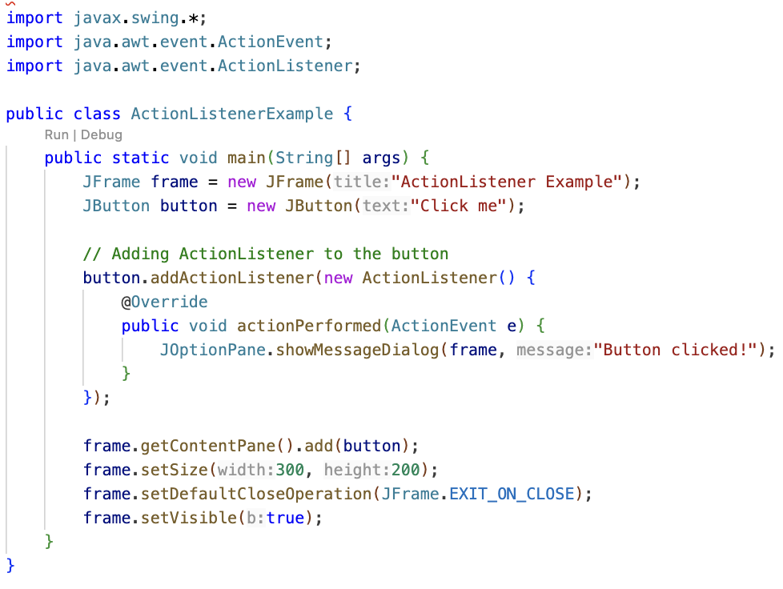
Creating Button Object
Adding Action Listener to the button for showing the popup
Adding button to the frame

Slide 25
JavaFX
JavaFX is a set of Java graphics and media APIs for creating rich desktop and web applications.
It provides a modern, hardware-accelerated graphics pipeline for improved performance.
JavaFX supports animations and transitions to create visually engaging user interfaces.
JavaFX applications can be deployed as standalone desktop applications or as applets within web browsers.

Slide 26
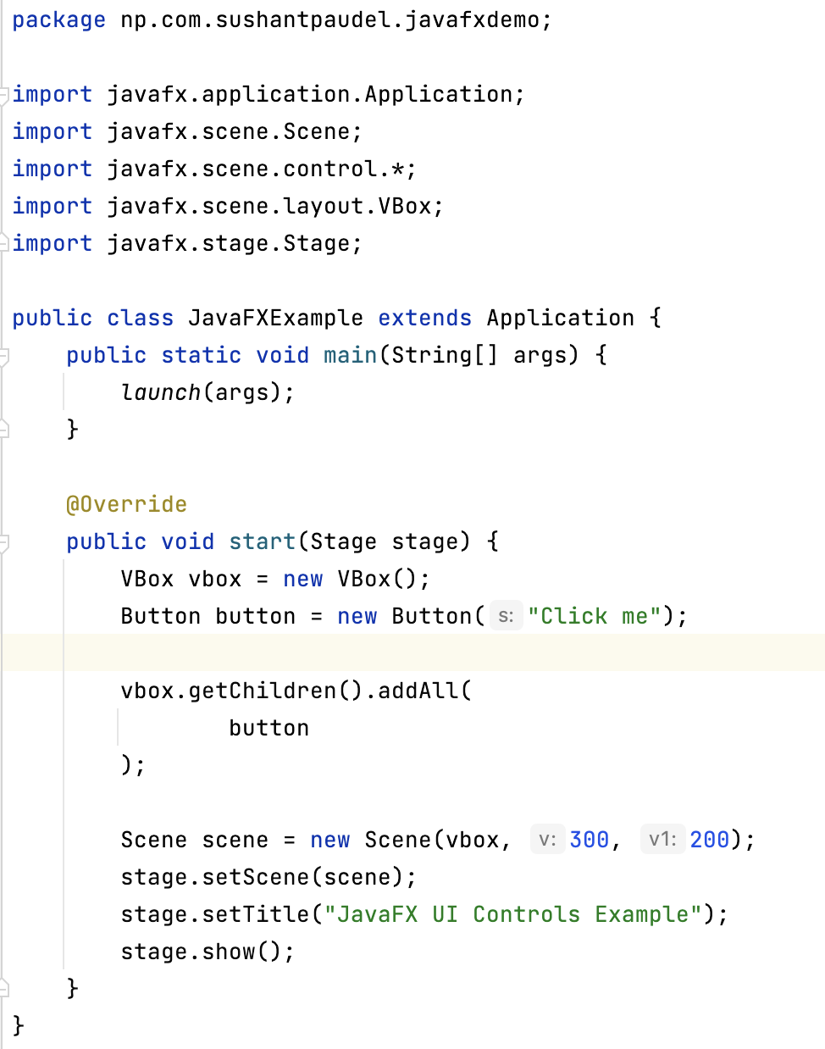
In a JavaFX application, the Application class is typically extended to create the main application class.
The launch method is a static method provided by the Application class in JavaFX.
It is used to launch the JavaFX application.
Overriding the start method, which serves as the entry point for the JavaFX application

Slide 27
JavaFX vs Swing
JavaFX | Swing
Modern GUI toolkit for Java. | Older GUI toolkit, introduced in Java 1.2.
Part of the Java Standard Edition since Java 8. | Built on top of AWT (Abstract Window Toolkit).
Uses a scene graph for rendering, allowing for more sophisticated graphical effects. | Lightweight components, not tied to the underlying operating system.
Supports a declarative XML-based language (FXML) for defining UIs. | Mature and stable, widely used in legacy applications.
Has built-in support for multimedia, 3D graphics, and web technologies. | Easier to integrate with existing AWT-based code.

Slide 28
JavaFX Layouts
VBox and HBox:
Vertical and horizontal box layouts.
Components are arranged in a single column (VBox) or row (HBox).
BorderPane:
Divides the layout into five regions: top, bottom, left, right, and center
StackPane:
Stacks components on top of each other.
GridPane:
Grid-based layout, allowing components to be placed in rows and columns.
FlowPane:
Components flow in a wrap-around manner, adjusting their position based on available space.

Slide 29
JavaFX UI Controls
Button: Represents a clickable button.
TextField: Allows users to input text.
CheckBox and RadioButton: For binary and exclusive selection, respectively.
ComboBox: A drop-down menu with a list of options.
Slider: Allows users to select a value from a range.
TableView: Displays tabular data in rows and columns.
DatePicker: Enables users to pick a date from a calendar.
WebView: Embeds a web browser in the application.

Slide 30
Thank You

